Slide 1
INTERNAL ASSESSMENT
SWEATHA S
EMP ID: 4398

Slide 2
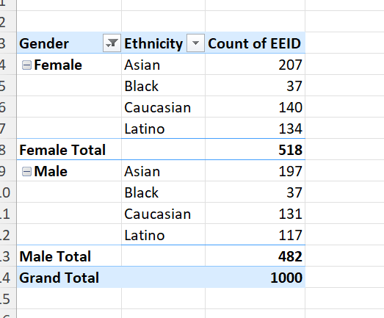
GENDER AND ETHNICITY DISTRIBUTION
A pivot table has been created to provide the gender wise distribution of ethnicity.
It is observed that Asian people dominate in both females and males. And the people belonging to Black ethnicity are least in number in both gender

Slide 3
Q2

Slide 4
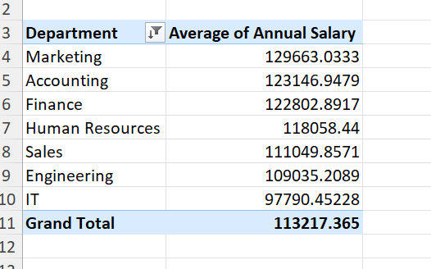
AVERAGE SALARIES OF DEPARTMENTS
Yes, there is a significant difference in average salary between marketing and IT of around 30000.

Slide 5
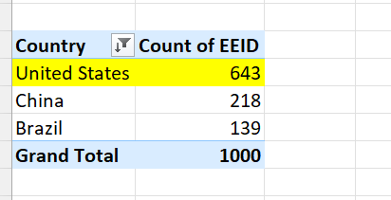
Q 4
The country having highest number of employees is United states

Slide 6
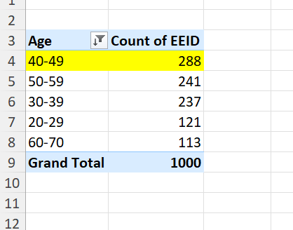
Q 5
Most common range among employees is 40 – 49.

Slide 7
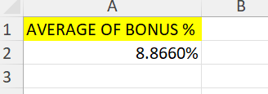
Q 6
Average bonus given to employees is 8.86%

Slide 8
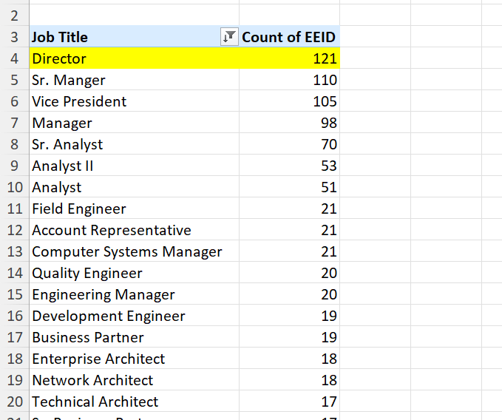
7
Director occurs most frequently in dataset

Slide 9
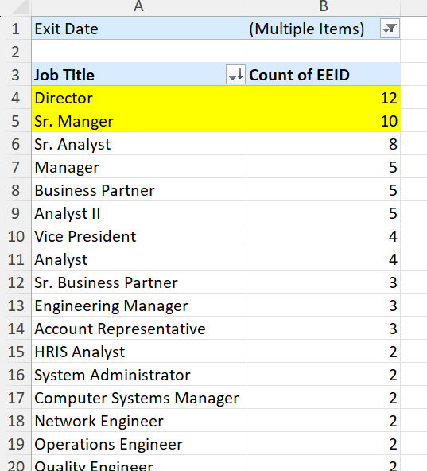
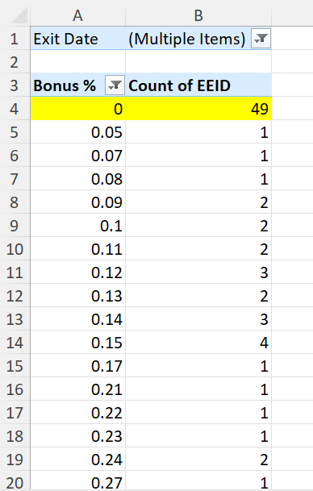
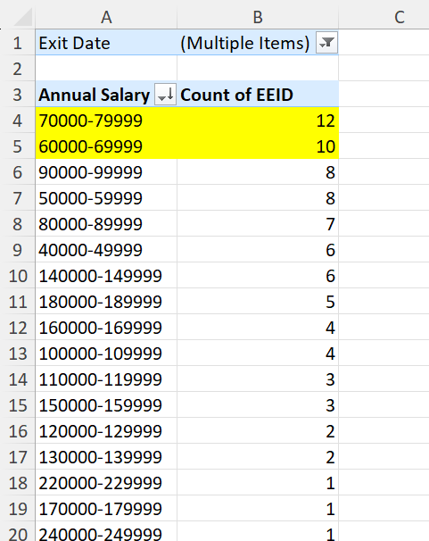
8

Slide 10
8
Reasons for employees exit:
Can be bonus being 0% and annual salary being less and director is the most common job title exiting

Slide 11
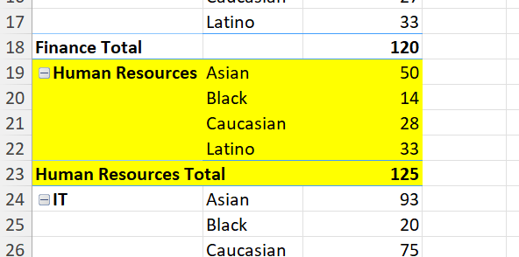
9
Human resources is more diverse in terms of ethnicity

Slide 12
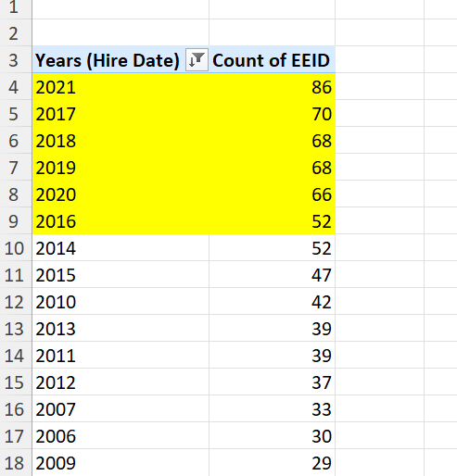
10
There is an increase in the number of hires over the past few years

